Slide 1
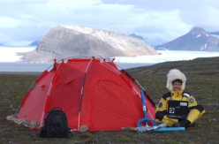
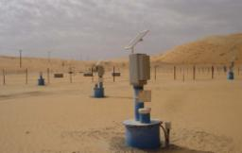
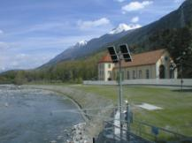
SEBA Hydrometrie GmbH & Co. KG
State of the Art Technology in Hydrometry
presented by
Jens Petry

Slide 2
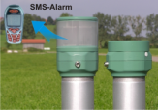
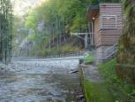
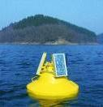
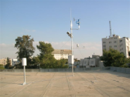
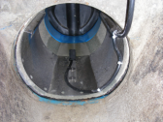
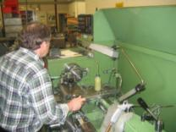
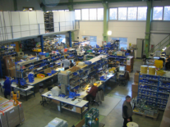
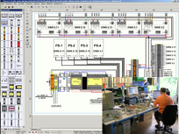
Founded in 1967 in Germany
Groundwater
Surface Water
Water Quality
Meteorology
Discharge
Interdisciplinary team
Notes:
SEBA Hydrometrie has an interdisciplinary team oft highly experienced professionals, e.g. such as electrical / mechanical- / IT-software / hardware engineers.
Short administrative channels
Privately owned company / no pressure from shareholders.
Very flexible to respond to special requirements form clients
Equipment & software design + production all “under one roof”

Slide 3
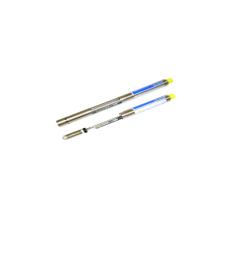
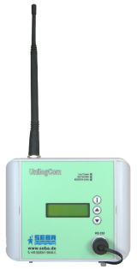
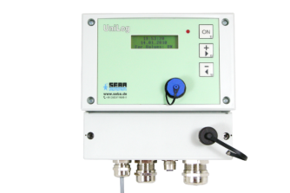
Sensor and Logger Systems
Data logger: UnilogCom
- Multi-channel data logger
- Time-, dynamic- or event controlled
- Up to 32 inputs possible
- Integrated GSM/GPRS modem
- Alarm management
Data logger: Unilog
- Multi-channel data logger
- Interfaces: RS232, RS485
- USB stick, USB mini
- GSM/GPRS, Satellite transmission
- Lan module (optional)
- Alarm management
Notes:
Data logger for the storage and data transmission of analogue and digital values
Interfaces: RS232, RS485
Inputs:
RS485 sensor interface
SDI 12 sensor interface optional
2 contact inputs
2 analogue inputs as standart
LC-Display
Functional Keys for easy operation
Storage of up to 4 MB, 280.000 values
High data security low power consumption
Additional inputs possible with external module (Met-Controller)
Time server synchronisation
Protection class IP 65
Operating temperature -30C-……..+ 70C

Slide 4
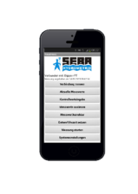
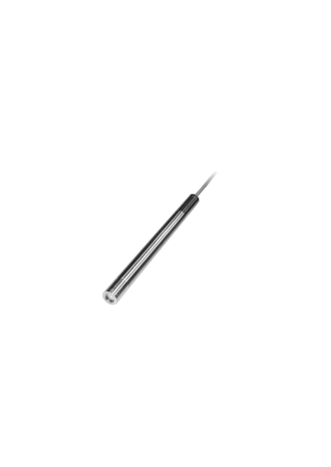
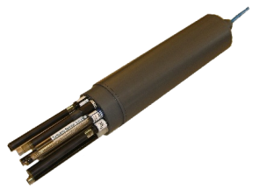
Sensor and Logger Systems
Groundwater & Surface Water
Sensor / integrated data logger & power supply
Pressure & Temperature Sensor: DST-22 / Dipper-PT:
Water Quality Sensor with WL, T, EC: MPS-PTEC/ Dipper-PTEC
Water Quality Sensor with 8 parameters: MPS-D8/ Qualilog-8
Water Quality Sensor with 12 parameters: MPS-K16 / Qualilog-16

Slide 5
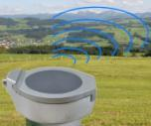
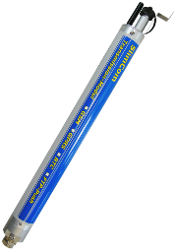
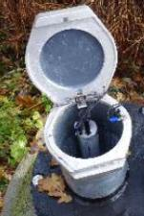
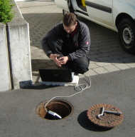
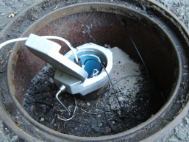
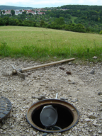
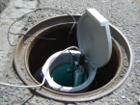
Sensor and Logger Systems
SlimLogCom
Extra slim data transmission system for observation wells of 1½ “
Data transmission via GSM/GPRS network:
- Data push to FTP servers
- SMS data transmission
- SMS Alarm
DS 22 (wl)
DST22 (wl,t)
MPS-PTEC (wl,t,ec)
DS 22 (wl)
DST22 (wl,t)
MPS-PTEC (wl,t,ec)
Notes:
Extra slim data transmission system for observation wells of 1 ½ “
Data transmission via GSM/GPRS network:
Automatic data retrieval
Data push to FTP servers
SMS data transmission
SMS Alarm
Time-Server synchronisation
Memory 280.000 values, up to 32 channels

Slide 6
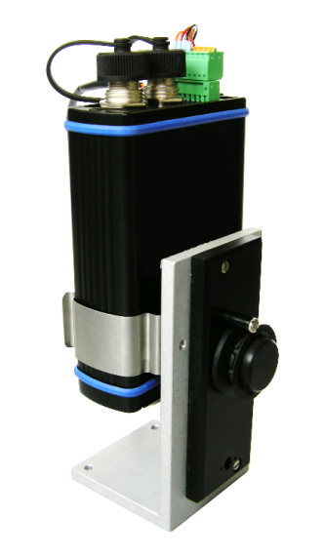
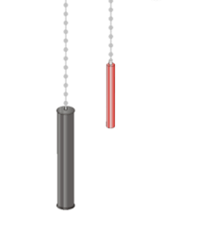
Sensor and Logger Systems
LevelSense Encoder
Outputs:
RS485, RS232
4-20mA
SDI-12
Stand alone unit (9 Volt battery)
Counterweight
Combined with data logger
UniLog-Light ENC
Floater

Slide 7
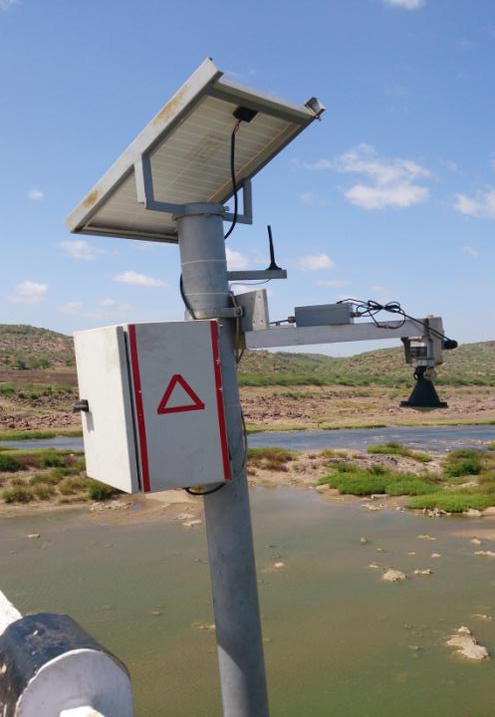
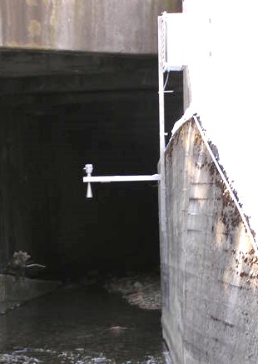
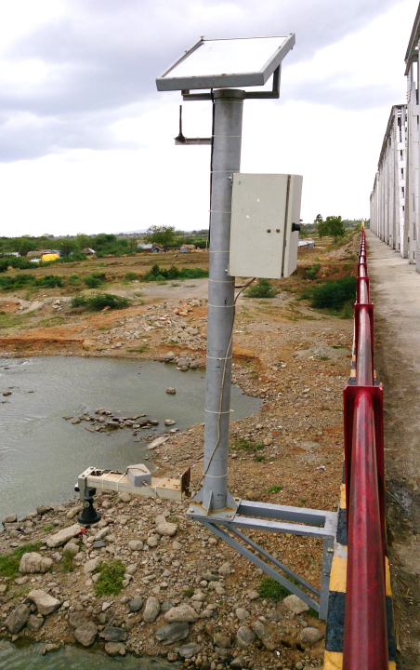
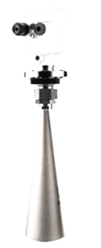
Sensor and Logger Systems
Contact free measurement
Measurement not affected by environmental conditions
Radar Sensor measurement of surface water level through runtime of an emitted radar sensor impulse
Measuring Ranges
0-15m – 0-70m
SEBAPuls 15
SEBAPuls 20
SEBAPuls 30
SEBAPuls 70

Slide 8
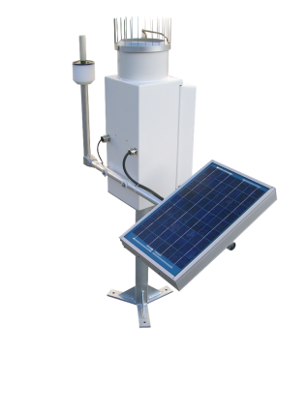
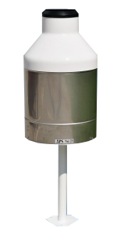
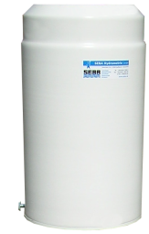
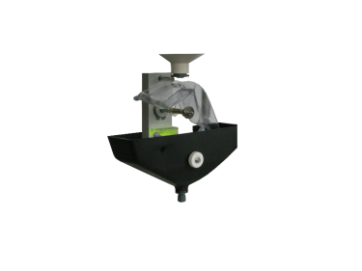
Sensor and Logger Systems
Sensors for Meteorology (Precipitation)
Rain Gauges (Tipping Bucket and Weighing Systems)
Telemetric Rain Gauge RG100
with IRIDIUM-Satellite
Transmission
Tipping Bucket System
Rain Gauge TRW
Notes:
Here just an overview about the available options

Slide 9
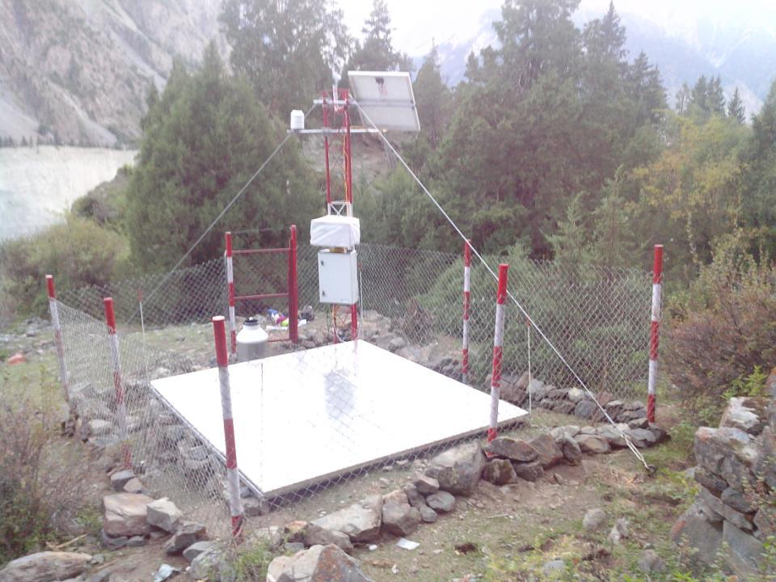
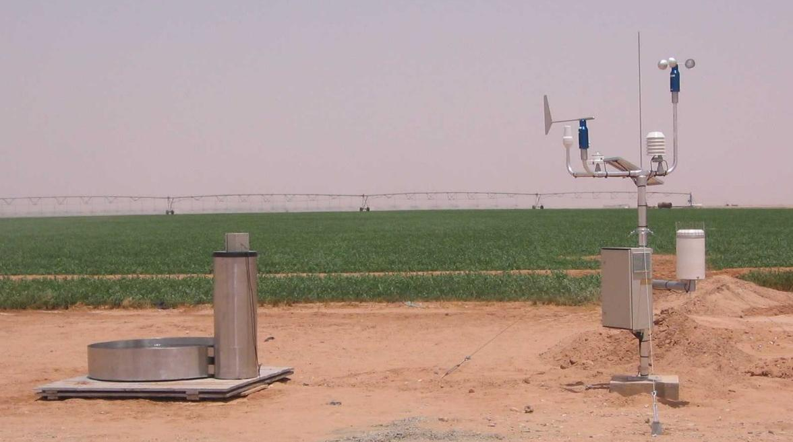
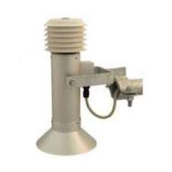
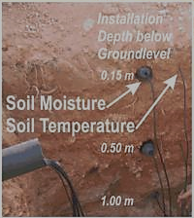
Sensor and Logger Systems for Meteorology

Slide 10
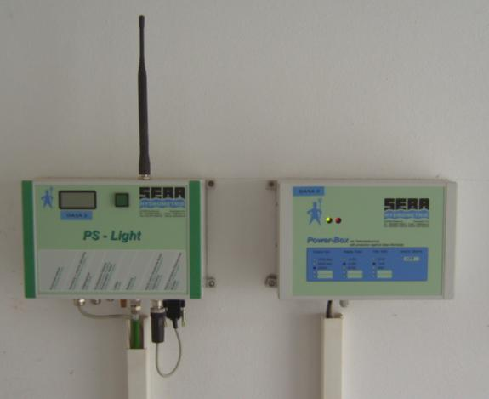
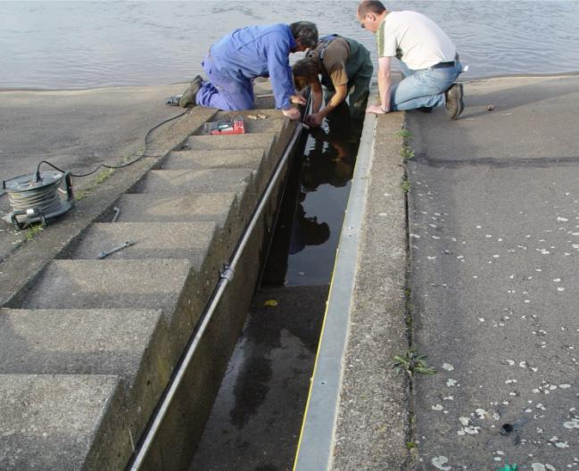
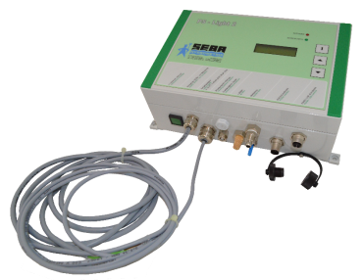
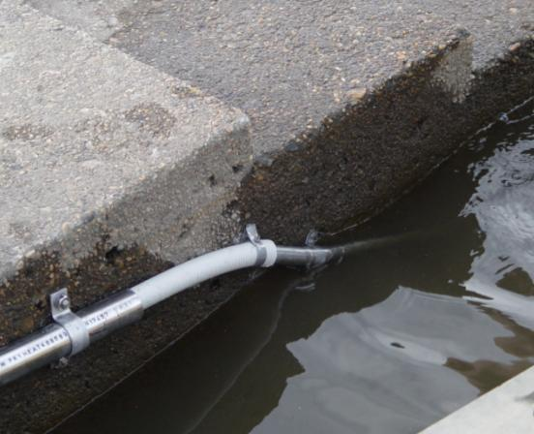
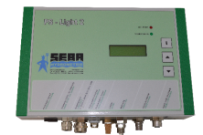
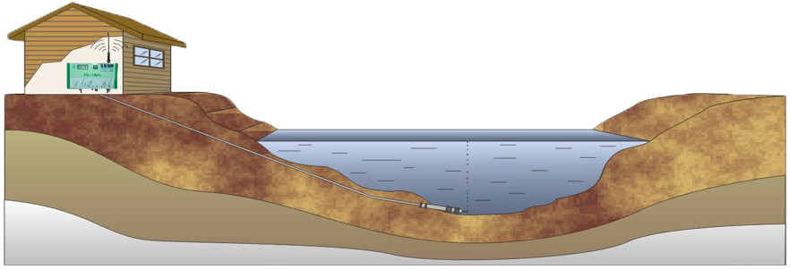
PS-Light-2 Bubbler System
Sensor and Logger Systems
Economic measuring system
Highly precise and robust by drift-free sensing due to automatic 0-point calibration
Low energy consumption due to intelligent pump control
Notes:
only sensor with signal output
(e.g. 4-20 mA, BCD, SDI-12)
with integrated data logger and GSM / GPRS modem
with multilevel measurement for reservoirs

Slide 11
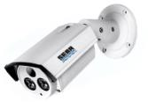
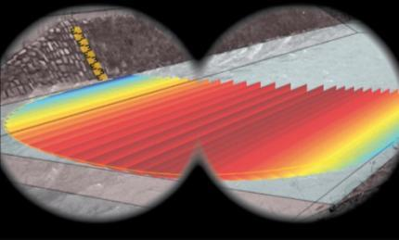
DischargeKeeper
The newest SEBA-innovation
flow velocity profiling, water level and discharge acquisition
Notes:
Now we come to our newest innovation in the discharge measring‘s methods: The DischargeKeeper

Slide 12
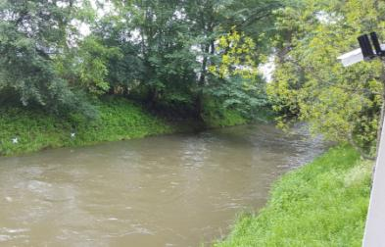
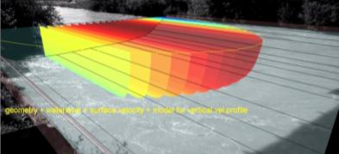
DischargeKeeper
A non-contact, optical flow measurement for natural water streams, irrigation and waste water channels
Key Features
Camera-based measurement system for acquisition of the surface velocity profile
and the water level
Direct calculation of the discharge
Non-intrusive measurement method
using only one sensor (camera)
Data storage and remote transmission of measurement data images and videos
Connections for further sensors
Intelligent alarm management
Notes:
DischargeKeeper
Berührungslose Messung des Fließgeschwindigkeitsprofils und Durchflusserfassung
Besonderheiten
• Kamerabasiertes Messsystem zur direkten Erfassung des Fließgeschwindigkeitsprofils der Wasseroberfläche in natürlichen Fließgewässern, Abwasserkanälen und Rückhaltebecken
• Direkte Erfassung des Wasserstands
• Vor-Ort-Durchflusserfassung
Kein Zufuhr von Tracern notwendig

Slide 13
Application in the Hydrology Sector

Slide 14
Time for questions
Contact Details SEBA Hydrometrie
(India)
Mr Ram Warriar
E-mail: warriar@seba.de
Phone: 0091 9867299020
Skype : ram.warriar2
Contact Details SEBA Hydrometrie
(Scotland / Germany)
Dr Jens Petry
E-mail: petry@seba.de
Landline: 0044 131 618 6190
Skype : sebajpetry

